Slide 1
JEE – Servlets

Slide 2

Objectives
At the end of this session, you will be able to,
Describe Web Architecture
Describe structure of Web Application
Define Servlets
Describe Life Cycle of Servlets
Describe Servlet API
Design, Deploy and execute Servlet Program on application server
Describe and Demonstrate Servlet Config and Servlet Context
Describe and Demonstrate InterServlet Communication
Describe State Management and its ways
Describe and Demonstrate Connection Pooling using JNDI
Copyright © 2016 Tech Mahindra. All Rights Reserved.

Slide 3

Agenda
Following points to be covered in the session,
Web Component
Servlets
Life Cycle of Servlets
Servlet API
Servlet Configuration with annotations
Servlet Config and Servlet Context
InterServlet Communication
JNDI and DataSource Configuration on Application Server
Filters and Listners
State Management
State Management techniques
CONFIDENTIAL© Copyright 2008 Tech Mahindra Limited
Copyright © 2016 Tech Mahindra. All Rights Reserved.

Slide 4
Web Component
Copyright © 2016 Tech Mahindra. All Rights Reserved.

Slide 5
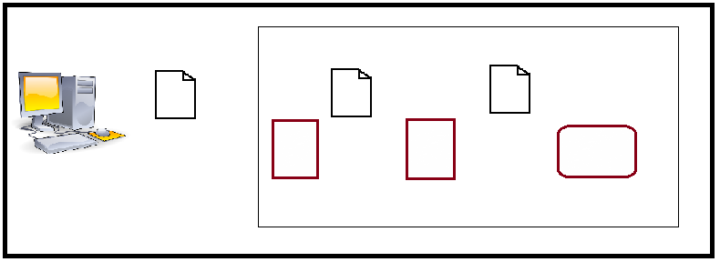





Web Architecture
Web or App Server machine
request
request
request
GET
GET
GET
Client / Browser
Web Container
Web Component
Server
Web or App Server machine
response
response
response
-----
-----
------
-----
-----
------
-----
-----
------
Client / Browser
Server
Web Container
Web Component
Copyright © 2016 Tech Mahindra. All Rights Reserved.
Notes:
Web server is the one who hosts web applications and listens on port number 80. Any HTTP request made by web client is handled by web server application. When the server application gets a request for a web component, the server hands the request to the container in which the web component is deployed. It’s the container that gives the component the HTTP request and response objects. The web component places gives the response object to the web container which gives it back to the server application which in turn gives it to the client.

Slide 6
Web Application
A Web application is a dynamic extension of a Web server.
A Web application consists of Web components, static resource files such as images, and helper classes and libraries
Web components provide the dynamic extension capabilities for a Web server.
Web components are either Java Servlets or JSP pages.
Web components are supported by the services of a runtime platform called a Web container.
  The Web container provides services such as request dispatching, security, concurrency and life cycle management.
  It also gives Web components access to APIs such as naming, transactions, and e-mail
Copyright © 2016 Tech Mahindra. All Rights Reserved.

Slide 7
Web Application
Certain aspects of Web application behavior can be configured when the application is deployed to the Web container.
The configuration information is maintained in XML format called a Web application deployment descriptor(web.xml).
Web components and static Web content files such as images are called Web resources.
A Web module is the smallest deployable and usable unit of Web resources in a J2EE application.
Copyright © 2016 Tech Mahindra. All Rights Reserved.

Slide 8
Web Application Creation …..Steps
The process for creating, deploying, and executing a Web application can be summarized as follows:
  Develop the Web component code (including deployment descriptor or annotations).
  Build the Web application components along with any static resources (for example, images) and helper classes referenced by the component.
  Install or deploy the application into an Application Server.
  Access a URL that references the Web application.
Copyright © 2016 Tech Mahindra. All Rights Reserved.

Slide 9


Structure of a Web Application
MyWebApp
*.html
*.jsp
WEB-INF
web.xml - configuration setting of application
classes
*.class - all the classes used in app
Copyright © 2016 Tech Mahindra. All Rights Reserved.
Notes:
The top-level directory of a Web module is the document root of the application. The document root is where JSP pages, client-side classes and archives, and static Web resources are stored. The document root contains a subdirectory called WEB-INF, which contains the following files and directories: web.xml - The Web application deployment descriptor
Tag library descriptor files (see Tag Library Descriptors)
classes - A directory that contains server-side classes: servlets, utility classes, and JavaBeans components
lib - A directory that contains JAR archives of libraries called by server-side classes
You can also create application-specific subdirectories (that is, package directories) in either the document root or the WEB-INF/classes directory.
You can create a war file of this application folder and deploy it in application server or deploy it in exploded form.

Slide 10
Web Development
Web development has two aspects,
  Client side technologies
    HTML – lightweight markup language which is a W3C std
    DHTML – Dynamic effects can be introduced using
    Applet - Sun
    Java script – Netscape
    Vb Script – Microsoft
    Style sheets
    Angular JS
    JQuery
Copyright © 2016 Tech Mahindra. All Rights Reserved.
Notes:
Different client side technologies are available like..

Slide 11
Web Development (Contd.)
  Server side technologies
    CGI – Common Gateway Interface
    ASP – Active Server pages, interpreted platform dependent technology from Microsoft
    Servlet /JSP – object oriented, compiled, platform independent technology from sun microsystem.
    ASP.Net – Object oriented ,platform independent web technology from Microsoft.
Copyright © 2016 Tech Mahindra. All Rights Reserved.
Notes:
Server side technologies are as follows:
CGI : It is old technology which is not in use now days due to performance issues.
ASP : technology given my microsoft and thus it is not free.. ☺
Servlet / JSP : Will explore next..
ASP .net : technology by microsoft and requires registered version to be purchased.

Slide 12
Need for Server Side Technology
Processing client request
Implementing Business logic
Generating HTML response for client
If resource is not available then generate appropriate error message
Making data access from various databases
Copyright © 2016 Tech Mahindra. All Rights Reserved.

Slide 13
Servlets
Copyright © 2016 Tech Mahindra. All Rights Reserved.

Slide 14
Servlets
A servlet is a Java class used to write server side programming logic which executes after client send request.
A servlet is accessed via a request-response programming model
Features and Advantages :
  Platform Independent
  Access to Java APIs
  Efficiency and endurance
  Safety
  Extensibility and flexibility
Copyright © 2016 Tech Mahindra. All Rights Reserved.
Notes:
Features and Advantages of Servlets
The advantages of servlets are as follows:
1. Portability
Servlets are supported on all platforms that support java and servlets work with all the major web servers. They are highly portable across operating systems and across server implementations. A servlet can be developed on a Windows NT machine running the tomcat server and later deploy it effortlessly on a high end Unix server running the iPlanet/Netscape application server.
2. Power
Servlets has full power of the core Java APIs: Networking and URL access, multithreading, image manipulation, data compression, database connection (JDBC), object serialization, remote method invocation (RMI), and legacy integration (CORBA). Servlets can also take advantage of the J2EE platform.
3. Efficiency and endurance
Sevlet stays in server’s memory as a single object instance, it automatically maintains its state and can hold on to external resources.
4. Safety
As they are written in Java, servlets inherit the strong type safety of java language.
5. Integration
Servlets are highly integrated with the server. This integration allows a servlet to cooperate with the server in ways that a CGI program cannot.
6. Extensibilty and flexibility
Servlets could be extended and optimized for another type of servlets.They can create simple content using out.println() statements, or they can generate complicated sets of pages using a template engine.

Slide 15
Servlet Architecture
80
Servlet
engine
e
http://......./servlet/search
init()
Web client - Browser
.class
Copyright © 2016 Tech Mahindra. All Rights Reserved.
Notes:
This slide explains how servlet execution takes place. If a webclient makes a request for any servlet. Request is processed by webserver with the help of servlet engine who manages the entire life cycle of servlet. Instance of the servlet class is created by servlet engine. Any further request to the same servlet is executed as new thread on the same servlet instance.

Slide 16
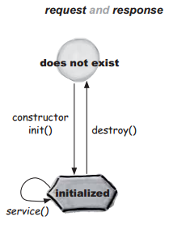
Lifecycle of Servlet
Lifecycle methods from javax.servlet.Servlet interface
  init()
  called only once, used for initialization
  service()
  called for all the request, used for logic implementation
  destroy()
  Called before servlet engine destroys servlet instance
Servlet
Copyright © 2016 Tech Mahindra. All Rights Reserved.
Notes:
The life cycle of a servlet is controlled by the container in which the servlet has been deployed. Servlet class implements the Servlet interface and overrides the init() service() destroy() getServletConfig() getServletInfo() methods from the Servlet interface. Init() is called only once in the life cycle of a Servlet. Service() is where the business logic is written. Destroy() is called by the container when the container decides to garbage collect the Servlet object.

Slide 17
Request / Response Model
service() method of Servlet Interface receives two parameters. (ServletRequest and ServletResponse objects)
Request response object will be managed by servlet engine
Every user call is associated with Request and Response object
Request object will carry all the client details to server
Server will send information to client through Response object
Request object is loaded with Http headers which it will carry to the server
Copyright © 2016 Tech Mahindra. All Rights Reserved.

Slide 18
Web and Application Server
Few of the popular servers available in the market are :
Apache HTTP server
Web Server
Microsoft Internet Information Services ( IIS )
Oracle - Weblogic
Application Server
Red Hat - JBoss
Copyright © 2016 Tech Mahindra. All Rights Reserved.
Notes:
Apart from these types of servers we also have:
Mail severs
File servers
Proxy servers
Real-time servers
Could Servers
You can get more info on following link:
http://computechblogspot.blogspot.in/2012/12/different-types-of-servers-available-in.html

Slide 19
Web Container
Along with server we need one more entity to function i.e. Web Container. Eg Apache server has Tomcat web container.
Functionalities of Web Container
  Communications Support for Servlets to interact with Server
  Lifecycle Management for servlets
  Multithreading Support
  Declarative security using deployment descriptor
  JSP support
Copyright © 2016 Tech Mahindra. All Rights Reserved.

Slide 20








Web Container (Cont..)
When the request comes on server side following steps are performed..
HTTP request
Web or App Server machine
request
GET
response
servlet
Container
The container finds correct servlet based on URL in the request, creates or allocates thread for that request, and passes request ,response objects to that thread.
thread
Client / Browser
HTTP request
Web or App Server machine
servlet
GET
Container
thread
The container calls service method of servlet. Further servlet can call doGet() or doPost() based upon request received. Lets consider doGet() for now
request
service(..)
Client / Browser
response
Copyright © 2016 Tech Mahindra. All Rights Reserved.

Slide 21


Web Container (Cont..)
Once the response is sent back to Client, following objects created in memory are destroyed as they contain client’s request data
  thread
  request
  response
Servlet instance will be there in memory to serve other client requests. It will only be removed if server shuts down or application is removed from server.
Web or App Server machine
servlet
thread
response
doGet() generates dynamic page and stores the page into response object. Container manages this efficiently.
service(..)
Client / Browser
doGet(..)
Copyright © 2016 Tech Mahindra. All Rights Reserved.

Slide 22
J2EE API
Servlet
  Must be implemented by all servlets
ServletConfig
  Provides servlet configuration information
ServletContext
  Provides information about the servlet container
ServletRequest
  Provides information about the client request
ServletResponse
  Used to send information to the client
RequestDispatcher
  Used to communicate with other servlets
SingleThreadModel
  Implemented by servlets to control concurrent access
Copyright © 2016 Tech Mahindra. All Rights Reserved.

Slide 23
J2EE API
GenericServlet
  Implements interfaces: Servlet, ServletConfig
  Implements all functions except service()
ServletInputStream
  Allows reading raw bytes from client
ServletOutputStream
  Allows writing raw bytes to client
ServletException
  Is thrown when the Servlet reaches a problem which prevents it from completing a request
UnavailableException
  Extends ServletException
  Used to indicate unavailability of service
  Can be temporary or permanent
Copyright © 2016 Tech Mahindra. All Rights Reserved.
Notes:
Generic servlet - Defines a generic, protocol-independent servlet. To write a HTTP servlet for use on the Web, extend HttpServlet instead of
GenericServlet.

Slide 24
HttpServlet
Interface
Servlet
Serializable
ServletConfig
Class
Generic
Servlet
Used for all type of protocol – generic Protocol
service( ServletRequest req, ServletResponse resp)
HttpServlet
Meant for Http Protocol.
service( HttpServletRequest req, HttpServletResponse resp)
doGet() - used for handling GET Method
MyServlet
doPost() - used for handling POST Method
Copyright © 2016 Tech Mahindra. All Rights Reserved.
Notes:
Servlet interface is implemented by GenericServlet which is extended by HttpServlet. Using HttpServlet helps you in handling requests according to the Http commands like Get, Post and so on.
Provides an abstract class to be subclassed to create an HTTP servlet suitable for a Web site. A subclass of HttpServlet must override at least one method, usually one of these: doGet() or doPost() where the request from the client is processed. We will see the difference between the doGet() and doPost() in one of the next few slides.

Slide 25
HTTP Request Methods
Get Request / doGet ()
  Is mainly used to get the data from the server, even though it can be used to send the data also to the server.
  The data that is sent gets appended to the URL as a query string
  The data gets exposed in the browser, so security is an issue here
  There is a limitation to the size of the data that can be sent using this method
Post Request / doPost()
  Is mainly used to post the data to the server, even though it can also be used to get the data from the server
  The data is passed in the HTTP body
  The data does not get exposed in the browser
  Since the data is placed in the HTTP body, there is no limitation to the size of the data sent
Copyright © 2016 Tech Mahindra. All Rights Reserved.
Notes:
When to use which method
If the client is only trying to retrieve information from the server get is advised. If the client wants to post the data to the server, post is advised.

Slide 26

HTTP Request Methods (Cont..)
Best Practices : Use POST method for secure data transfer in an application. Eg . For credentials transfer / netbanking / sending credit card details.
Follow java standards and naming conventions while coding. It avoids ambiguities and makes it easy to maintain the application.
Copyright © 2016 Tech Mahindra. All Rights Reserved.

Slide 27
Getting client data in Servlet
When the control comes from front end to Server, web component Eg. Servlet handles the request.
Client or request data is available in HTTPRequest object inside service().
To retrieve the data following syntax can be used.
Web or App Server machine
request
request
request
GET
GET
GET
Client / Browser
Web Container
Web Component
Server
String data=request.getParameter(“requetedInput”);
OR
String[] values=request.getParameterValues("habits");
Copyright © 2016 Tech Mahindra. All Rights Reserved.
Notes:
Guiding Points:
If you are expecting a single value , then use request.getParameter();
If you are expecting multiple values (Eg, in case of checkbox or multiselect), then use request.getParameterValues();

Slide 28
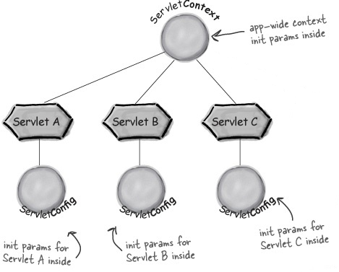
Servlet Config and Servlet Context
These are the two important interfaces which provide environmental support to the web application. When we want to pass any configuration information to a single servlet or multiple web components in web application we can use them.
  ServletConfig
  ServletContext
Copyright © 2016 Tech Mahindra. All Rights Reserved.

Slide 29
ServletConfig Interface
ServletConfig allows Servlets to obtain Servlet specific configuration information like initialization parameters
  public void init(ServletConfig config) throws ServletException
  {
  super.init(config);
  String greeting = config.getInitParameter("greeting");
  }
  web.xml
  <servlet>
  <servlet-name>init</servlet-name>
  <servlet-class>InitCounter</servlet-class>
  <init-param>
  <param-name>greeting</param-name>
  <param-value>Welcome to learn Initialization Parameters</param-value>
  </init-param>
  </servlet>
Copyright © 2016 Tech Mahindra. All Rights Reserved.
Notes:
If there are any variables which needs one time initialization in the life cycle of the servlet, they need to be initialized in the init() method. The ServletConfig object is passed as an argument to the init() method. The super.init() has to be called in the init() method of your servlet, only then the ServletConfig object will be available to the other methods in your servlet, otherwise it will become a local variable to the init() method and it will be accessible only to the init() method.
There is one ServletConfig object for every servlet in a web application. Before the container calls the init() method, it will construct a ServletConfig Object for that servlet. The ServletConfig object reads the initialization parameters from the web.xml.

Slide 30
ServletContext Interface
ServletContext allows application specific initialization parameters and also provides the ability for application components ( Servlets, JSP pages and Java beans ) to interact with each other.
There is one context per "web application" per Java Virtual Machine.
  public void init(ServletConfig config) throws ServletException
  {
  super.init(config);
  String greeting = config.getServletContext().getInitParameter("greeting");
  }
  web.xml
  <context-param>
  <param-name>greeting</param-name>
  <param-value>Welcome to learn Initialization Parameters</param-value>
  </context-param>
Copyright © 2016 Tech Mahindra. All Rights Reserved.
Notes:
Defines a set of methods that a servlet uses to communicate with its servlet container, for example, to get the MIME type of a file, dispatch requests, or write to a log file. Variables which should be visible to all the servlets and JSP’s in that web application should be declared as <contex-param> variables.

Slide 31
Servlet Configuration using Annotations
In Servlet 3.0 , web.xml is optional.
Configuration part is managed by annotation called @WebServlet and @WebInitParam . These are available in javax.servlet.annotation package.
urlPattern attribute is mandatory.
Annotations reduces complexity of managing web.xml.
Both annotation should be in .java file before the class starts.
E.g.
@WebServlet(urlPatterns = { “/MyServlet” })
public class MyServlet extends HttpServlet { ….}
@WebServlet
(
urlPatterns = "/imageUpload",
initParams = {
@WebInitParam(name = "saveDir", value = "D:/FileUpload"), @WebInitParam(name = "allowedTypes", value = "jpg,jpeg,gif,png")
}
)
Copyright © 2016 Tech Mahindra. All Rights Reserved.
Notes:
Extra Key points :
In servlet 3.0 web.xml contains a new attribute called metadata-complete on the web-app element. This attribute defines whether the web descriptor is complete or whether the class files of the web application should be examined for annotations that specify deployment info.
If the attribute is set to true, the deployment tool must ignore any servlet annotations present in the class files and use only the configuration details mentioned in the descriptor
Otherwise, if the value is not specified or is set to false, the container must scan all class files of the app for annotations. This provides a way to enable or disable scanning of the annotations and its processing during the startup of the application.

Slide 32
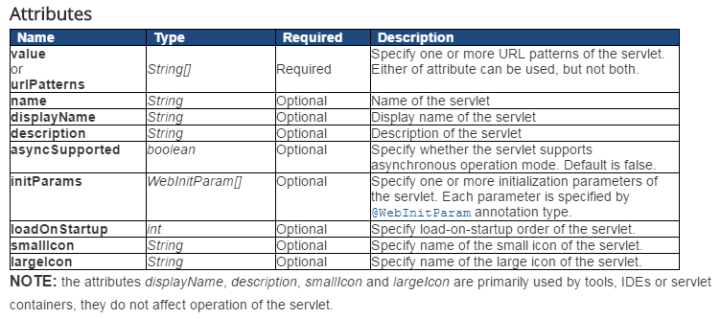
Servlet Configuration using Annotations (Cont..)
Copyright © 2016 Tech Mahindra. All Rights Reserved.

Slide 33
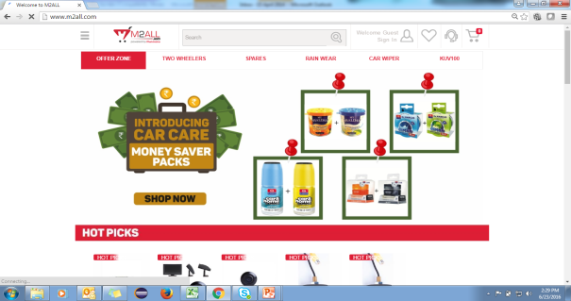


Brain Teaser..
Scenario 1 : In Shopping website like M2ALL.com customer does shopping by visiting multiple pages. We have created multiple HTML pages and Servlets till now.
How a control can go from HOME to Clothing section or any other section in
same website ?
Copyright © 2016 Tech Mahindra. All Rights Reserved.

Slide 34
Solution - RequestDispatcher
This is used to dispatch a request from one servlet to another (servlet / JSP/ HTML)
RequestDispatcher can be used to transfer the control within the same application.
Request data is also transferred along with the control. Thus it is accessible on next page.
Syntax to create RequestDispatcher is :
There are two ways to transfer the control :
RequestDispatcher rd=request . getRequestDispatcher(“URL”);
  rd.forward(request,response); //Transfers control to another servlet
//OR
  rd.include(request,response) //Calls another servlet and embeds its output into // current servlet’s output
Copyright © 2016 Tech Mahindra. All Rights Reserved.
Notes:
You can even get RequestDispatcher’s object by using context i.e.
RequestDispatcher rd=context . getRequestDispatcher(“URL”);

Slide 35
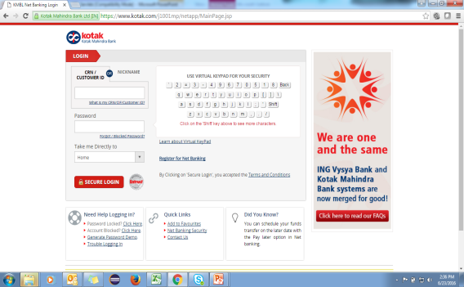
Brain Teaser..
Section 2 : After completing the shopping , user proceeds to pay. User chooses an option of internet banking or card payment. How a control can go from current website to another website ?
Copyright © 2016 Tech Mahindra. All Rights Reserved.

Slide 36
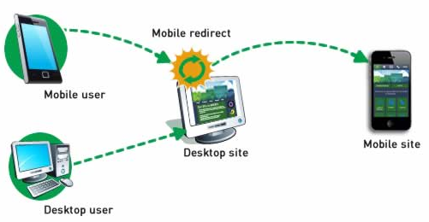
Solution - Redirection
Redirection is nothing but redirecting the control from one location to another because of logical reasons / the website is not available / URL is changed / for load balancing between servers etc.
Eg :
It can transfer the control to same web application or another web application.
Uses a new request object for new URL. Old is destroyed.
Syntax for redirecting is
response.sendRedirect(“URL”);
Copyright © 2016 Tech Mahindra. All Rights Reserved.
Notes:
This method sends back the response to the browser along with the status code and new page location. You can also use setStatus() and setHeader() methods together to achieve the same:
String site = "http://www.newpage.com" ;
response.setStatus(response.SC_MOVED_TEMPORARILY);
response.setHeader("Location", site);
Note :
You cant do redirect after writing to response.
sendRedirect() takes a string not a URL object.

Slide 37
InterServlet Communication
Another way of Communicating between servlets is using the sendRedirect() method of the Response object
RequestDispatcher | Redirect
The servlet decides that the request should go to another part of the web application (It may be a JSP or a Servlet component). | The servlet decides that the request should go to a completely different URL. Then the servlet calls the sendRedirect() method of the response object and sends back the response to the browser along with the status code. Then the browser sees the status code and looks for that servlet which can now handle the request. Again the browser makes a new request, but with the name of that servlet which can now handle the request and the result will be displayed to you by the browser. The URL will have the address of the new servlet.
This is used when the request has to be sent another web component in the same web application. | This is used when the request has to be sent to another URL in different application also.
The RequestDispatch is done by the server itself. | The redirecting is done by the browser here
Copyright © 2016 Tech Mahindra. All Rights Reserved.
Notes:
In send Redirect whenever the client makes any request it goes to the container, there the container decides whether the concerned servlet can handle the request or not. If not then the servlet decides that the request can be handled by another servlet or jsp. Then the servlet calls the sendRedirect() method of the response object and sends back the response to the browser along with the status code. Then the browser sees the status code and looks for that servlet which can now handle the request. Again the browser makes a new request, but with the name of that servlet which can now handle the request and the result will be displayed to you by the browser. The URL will have the address of the new servlet.

Slide 38
Brain Teaser..
In a shopping website when customer does shopping from various sections across different pages, He gets the final products list at the end. How it can be possible?
As the pages are different and the code written in them are different, how the
data is shared among different web components?
Copyright © 2016 Tech Mahindra. All Rights Reserved.

Slide 39
Solution - Scope objects available in servlet
Data in web application can be shared by using different scopes. In servlet we have following scopes.
  request
  session
  context
Syntax for the same is :
E.g. : storing username in request object
scope.setAttribute(key,value);
request.setAttribute(“username”, “Shweta”);
Copyright © 2016 Tech Mahindra. All Rights Reserved.
Notes:
Note : You can also store collection objects into the scope for sharing large amount of data.
Eg.
request.setAttribute(“selectList”, shoppingList);
Where shopping list is an arraylist containing items stored in shopping cart.

Slide 40
Explore & Learn ( for Participants ):
During programming and assignments you must have observed following errors in output. Identify the cause of those errors and match the pair from below table:
Error Code | Reason for Error
1XX , Eg . 100 | Redirection
2XX , Eg . 200 | Client Error
3XX , Eg . 300 | Informational
4XX , Eg. 404 | Server Error
5XX , Eg. 500 | Success
Copyright © 2016 Tech Mahindra. All Rights Reserved.

Slide 41
State Management
Copyright © 2016 Tech Mahindra. All Rights Reserved.

Slide 42
State management need & introduction
Need for State management
  Http Protocol is stateless protocol. It will not maintain the client’s state on server side.
  Dynamic applications are built on the assumption that the same client access the application multiple times. But if you use HTTP client’s data is lost with every request.
  Thus Server needs Client details and performs authentications for every request.
  To avoid frequent authentication issues and give user friendly access to website we need State management also called as Session Tracking. So that client data can be maintained on the server side.
Definition : State Management is nothing but maintaining the Client state for future reference.
Copyright © 2016 Tech Mahindra. All Rights Reserved.

Slide 43
Various ways
URL Rewriting
  Appending state information to url.
Hidden Fields
  HTML feature used for managing state.
Cookies
  State information is kept in a form of text file at client side.
Session
  Server side handling of state information.
Copyright © 2016 Tech Mahindra. All Rights Reserved.
Notes:
Using URL rewriting, information can be send across subsequent pages
Hidden field captures client info without his knowledge and sends it to server through submit action.
In case of cookies, Client information is captured by the server and it is stored in client machine.
Session objects are server side objects to maintain state info on the server
Servlet chaining is achieved through requestDispacther object, which sends state info through request, response object.

Slide 44
1. URL Rewriting
URLs can be rewritten or encoded to include session information.
URL rewriting usually includes a session id.
id can be sent as extra path information:
  http://.../servlet/Rewritten/688
  Works well if no need for extra path info.
id can be sent as an added parameter:
  http://.../servlet/Rewritten?sessionid=688
  Doesn't work with POST, cause name clash.
Id can be sent by a custom change technique:
  http://.../servlet/Rewritten;$sessionid$688
  May not work for all servers.
Copyright © 2016 Tech Mahindra. All Rights Reserved.
Notes:
Disadvantages :
URL Rewriting requires that all pages in the application to be dynamically generated. It can not be enforced for static HTML pages because the unique URL path parameter ( the jsessionid ) is dynamic.
If user book marks the URL and revisits the site using the book mark , the application can be accessed, which may poses a security threat.

Slide 45
2. Hidden Form Fields
Hidden form fields are another way to support session tracking.
Hidden form fields do not display in the browser, but can be sent back to the server by submit.
<FORM ACTION="/servlet/ShowParameters" METHOD="POST">
  <INPUT TYPE="HIDDEN" NAME="OCCUPATION" VALUE="ENGINEER">
  <INPUT TYPE="HIDDEN" NAME="SESSIONID" VALUE="194043">
</FORM>
Fields can have identification (session id) or just some thing to remember (occupation).
Servlet reads the fields using req.getParameter().
Copyright © 2016 Tech Mahindra. All Rights Reserved.
Notes:
Disadvantages :
Even though the form field is hidden it is available on client side in HTML form. Users can right click on browser and view the source for getting hidden form field.
Form fields can be used only on dynamically generated pages thus the use is limited.

Slide 46
3. Cookies
Used to store client specific information on client side
Introduced by Netscape, now a standard of HTTP protocol
Cookie is a small amount of information sent by a servlet to a Web browser, saved by the browser, and later sent back to the server.
The browser is expected to support 20 cookies for each Web server, 300 cookies total, and may limit cookie size to 4 KB each.
Cookie is sent to client through Response object. The browser returns cookies to the servlet by adding fields to HTTP request headers.
Cookies are of two types Persistent and Non-persistent.
  Persistent cookies are kept at client hard disk.
  Non–persistent cookies are maintained at browser memory.
Copyright © 2016 Tech Mahindra. All Rights Reserved.
Notes:
By default user sessions are maintained in Cookies. If Cookies are disabled on the client side,some other means of session management can be used.
Disadvantages :
Because cookies containing user specifi data are kept on the client side machines,there are certain security concerns in situations where the client machines are shared. Eg. Public net café / cyber café.

Slide 47
Servlet 3.0 updates
In servlet 3.0 specification allows cookies to be marks as HttpOnly cookies. These cookies are not exposed to client side scripting code.
JavaScript code written on the HTML file can not make use of cookies using setHttpOnly(boolean isHttpOnly) method.
To identify whether the cookies if HttpOnly or not,use boolean isHttpOnly() method.
This mechanism helps to prevent cross-side scripting attacks, meaning client side code can not use cookies to crack the server side code.
Copyright © 2016 Tech Mahindra. All Rights Reserved.

Slide 48
Cookie Execution
Non-Persistent
req
Cookies
e
Browser
resp
Persistent
Cookie
.class
Copyright © 2016 Tech Mahindra. All Rights Reserved.
Notes:
Consider a request comes to the server and while processing the request we want to store some client specific information. In the servlet or jsp page we can create cookies and store the client information into the same. Along with the response the cookies should be sent back to the client( browser). The browser receives the response and from the response it extracts the cookies and stores it. If the cookie is a persistent cookie it is stored in the file system, the exact location of which depends on the browser, on the other hand if it’s a non-persistent cookie it is stored in the memory of the browser. The next time a request is sent to the server the browser ensures the cookies are sent to the server again where the resource(servlet or jsp) can retrieve the cookies and hence the client information.

Slide 49
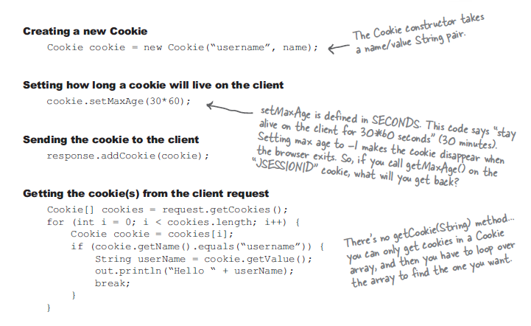
Programming Cookies
Copyright © 2016 Tech Mahindra. All Rights Reserved.

Slide 50
4. Session Management using HTTPSession
HttpSession interface is used to manage the sessions
Provides a way to identify a user across more than one page request or visit a web site and to store information about that user
Information about clients stored in server in the form of key and value
More secure
Can store any Java Object
Features are provided with help of methods of HttpSession. Eg. setMaxInactiveInterval() , invalidate() etc.
Copyright © 2016 Tech Mahindra. All Rights Reserved.

Slide 51
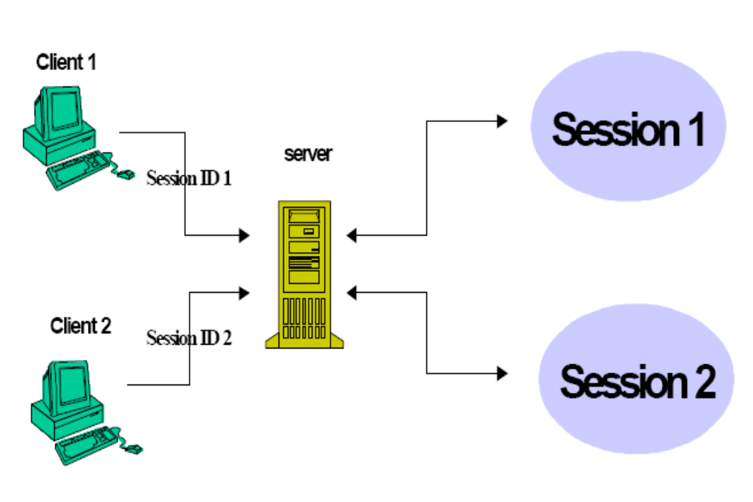
Session Execution
Copyright © 2016 Tech Mahindra. All Rights Reserved.
Notes:
As soon as client connects to server, server creates session object to store his state information. This process takes place for every client. Using session cookie server sends session id to all the clients, using this session cookie server identifies client and relates him to specific session object.

Slide 52
Session management in web application
Provides a way to identify a user across more than one page request or visit a web site and store information about that user
Session is an instance of HttpSession Interface managed by Servlet engine
The session persists for a specified time period, across more than one connection or page request from the user
Each session is identified by unique session id, which is sent to client using session cookie
Session can be changed if any of these factors in current session are changed
  User
  Time
  Browser
Copyright © 2016 Tech Mahindra. All Rights Reserved.
Notes:
Object Oriented
Object-Oriented design is a technique that helps the programmer visualize the program using real-life objects. Ease of use and Reusability are the other benefits of Object Orientation
Simple
Certain complex features like operator overloading, multiple inheritance, pointers, explicit memory de allocation are not present in Java language.
Robust
Two main reasons for program failure are related to: (1) memory management (2) run time errors
Memory management is very easy since the de allocation is done by the garbage collector automatically (more on this later)
Java provides object oriented exception handling to manage run time errors (covered late in Exception Handling).
Architecture Neutral / Portable (Write once, Run anywhere)
Java is an Interpreter based language. With Java, the program need only be compiled once, and the code generated by the Java compiler can run on any platform (discussed in detail later). If you are writing software for the World Wide Web, being able to run the same program on many different systems is crucial to that program's success. Java is platform independent at both the source and the binary level.
Java can be easily ported on any type of system and irrespective of the operating system being used. Java achieves this portability due to its feature of Implementation Independency.
Secure : can be used for internet based applications i.e we have applet small piece of code that can be downloaded and run on my machine. Applets are made to run in secured RunTime Environment they can’t use local resources.
How to handle distributed application again we will talk about the concept of RMI in Advanced Java.

Slide 53
Obtaining a Session
Generates the session id if not existing and keeps its reference in the Hashtable
public class Servlet1 extends Servlet
{
public void doGet(HttpServletRequest requset, HttpServletResponse response) throws IOException,ServletException
{
HttpSession hs=request.getSession();
}
}
Copyright © 2016 Tech Mahindra. All Rights Reserved.

Slide 54
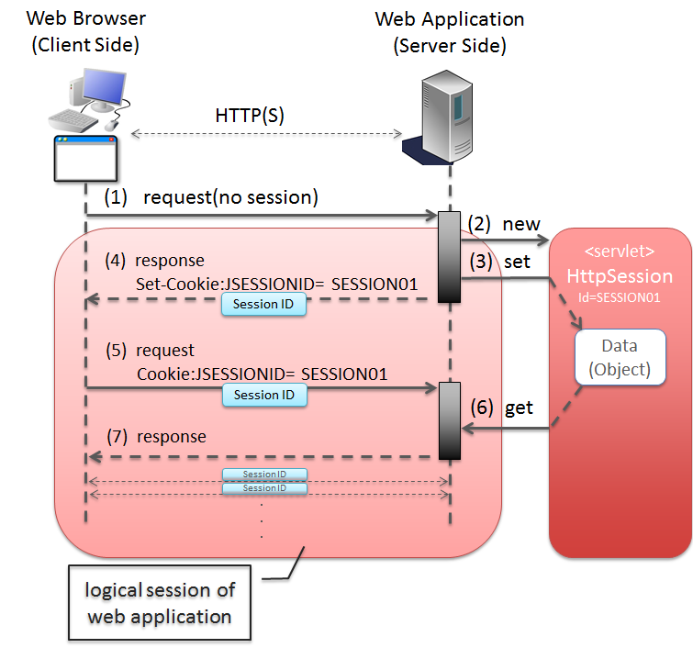
Overall Session Tracking in web applications
Copyright © 2016 Tech Mahindra. All Rights Reserved.

Slide 55
Explore and Learn ( For Participants )
Following methods can be useful in managing sessions in web application.
  setAttribute
  getAttribute
  removeAttribute
  invalidate
  setMaxInactiveInterval
  getId
  isNew
  [ Note : You can refer Java Docs for exploring these methods . ]
Copyright © 2016 Tech Mahindra. All Rights Reserved.
Notes:
You can use these methods during Case Study implementation.

Slide 56
State Management (Cont.. )
Best Practices : It is recommended to use combination of session tracking mechanisms based upon requirement.
E.g. Cookies and HTTPSession as mentioned in earlier diagram.
Copyright © 2016 Tech Mahindra. All Rights Reserved.

Slide 57

Summary
In this session, we have covered,
Web Component
Servlets introduction
Life Cycle of Servlets
Servlet API
Servlet Config and Servlet Context
Servlet using annotations.
Inter Servlet Communication
Scopes in Servlet
State Management and its techniques
Copyright © 2016 Tech Mahindra. All Rights Reserved.
Notes:
Self learning links :
https://docs.oracle.com/cd/E19644-01/817-5451/dwservlt.html
Books :
Head First Servlets and JSP

Slide 58
Thank You
Copyright © 2016 Tech Mahindra. All Rights Reserved.

